Slide 1
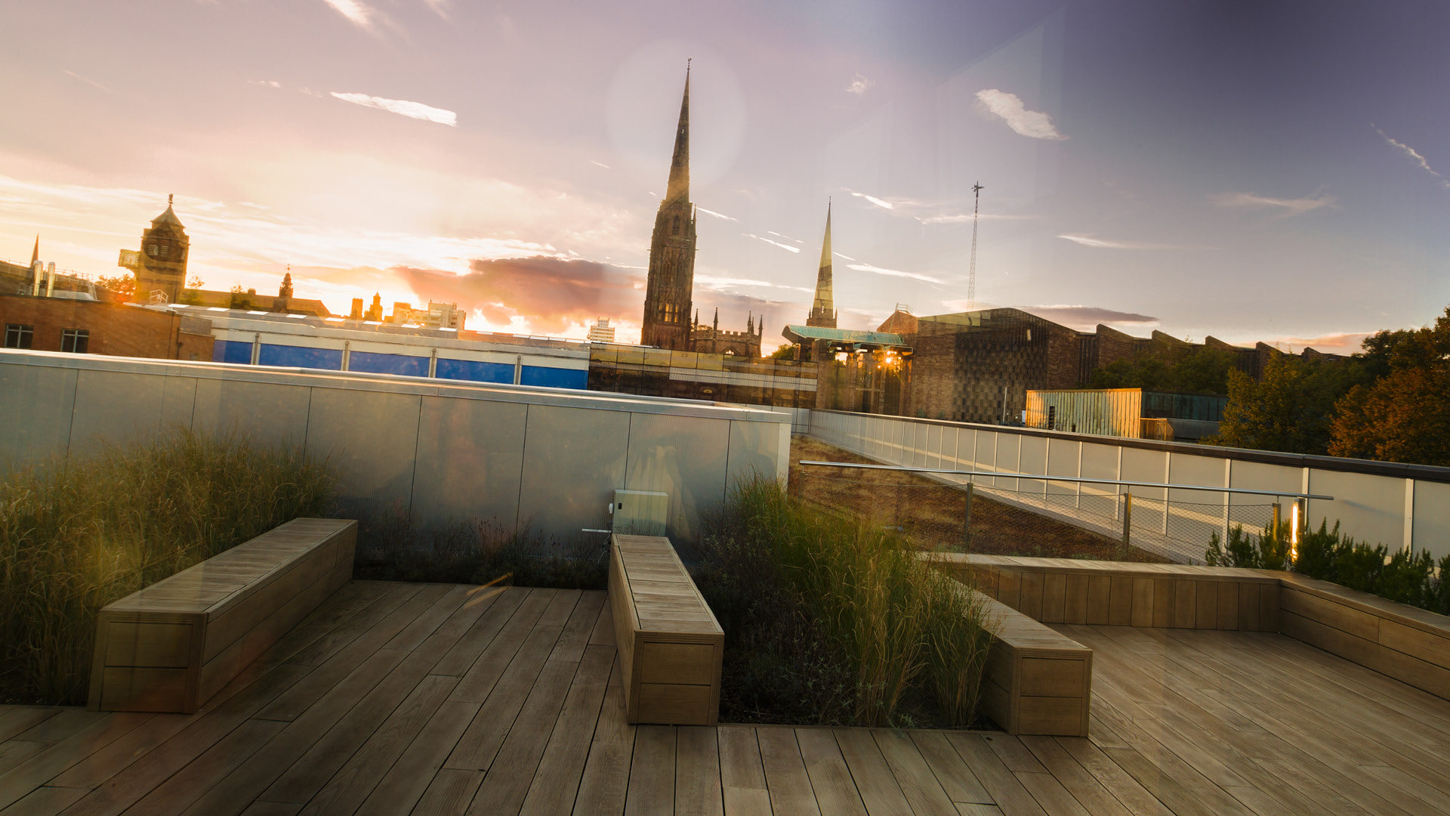

Research methods: Sensing, Monitoring and the Internet of Things Nepal - National Summer School, March 28th—March 30th 2018

Slide 2
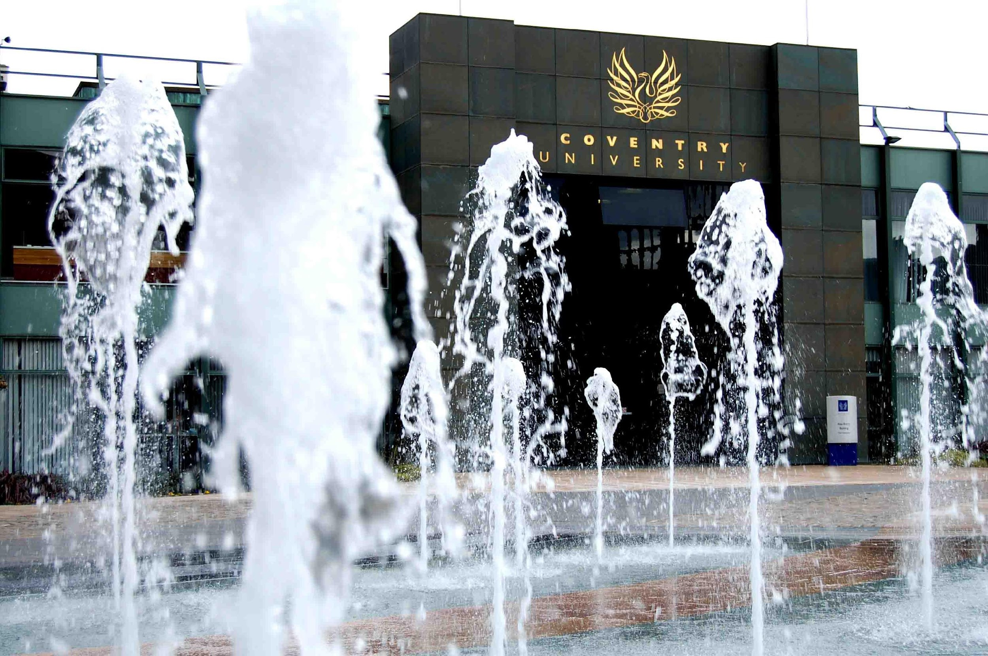
Sponsored by:
Engineering and Physical Research Council UK (EPSRC) through the HELP-Refugees project
Humanitarian Energy for Displaced Populations in Refugee Camps and informal Settings – HELP
Hosted by:
Softwarica IT College, Nepal
Delivered by:
Coventry University, Cogent labs team, Faculty of Engineering, Environment and Computing
Notes:
Invite Nishant to say a few words of welcome, unless he did so already

Slide 3
Welcome and introductions (30min)
Welcome from our hosts
Aims and purpose of the 3-day workshop
Introducing the speakers & audience
Motivations for attending and delivering the workshop
The bigger picture of academic inclusion
Indicative learning content
Agenda and setting expectations
Tinyos install help

Slide 4
Tutor profile – Professor Elena Gaura
Born and bred in Romania
BSc & MSc in Electronics – Cluj Napoca Romania, 1991
PhD in Intelligent sensors – Coventry, UK, 2000
Employed at Coventry University since 1999 on research roles – researcher, research leader, manager, Associate Dean for Research
Graduated 11 PhD students; acquired over 40 medium size/large grants
Grant evaluator for RCUK, EC, British Council, other national agencies worldwide
Keen interest in Researcher Development – core of my work since 2013

Slide 5
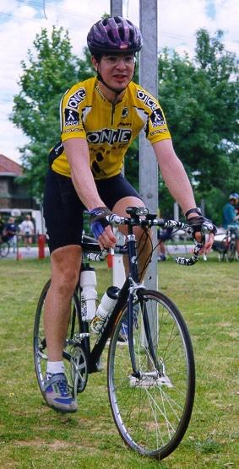
Tutor profile – Dr. James Brusey
Australian / British
Award winning PhD in Reinforcement learning for robot soccer
Cambridge U 2002 – 2007 (RFID, Robotics)
Coventry U 2007 – present (WSNs, etc!)
Graduated 9 PhD students (with Elena)
Currently supervise 10 PhDs students
Have recently run writing workshops for PhD students and Researchers in Cov U (3), India, Philippines, and Chile

Slide 6
Who we are, where we come from and why we are here?

Slide 7

Coventry University: Our accolades
Ranked No.12 UK University Guardian University Guide 2018
University of the Year 2015 Times Higher Education (THE) Awards
Modern University of the Year 2014, 2015, 2016 The Times and Sunday Times Good University Guide
Queen’s Award for Enterprise International Trade 2015

Slide 8

Coventry University: Our accolades
Top 4 for Student Experience and Teaching Quality The Times and Sunday Times Good University Guide 2017
95% of graduates employed or in further study DLHE survey 2014/15 – six months after graduating
Based in a city ranked top 40 worldwide, top 5 UK QS Best Student Cities 2017
91% of students satisfied with their course Q22, overall satisfaction, National Student Survey (NSS) 2016

Slide 9
Summer School - Aims and coverage
Aim to:
to improve your existing knowledge base
gather new core research skills
provide you with an understanding of IoT principles and applications
enable you to kick-start research in IoT and related fields
increase your confidence
Through:
lectures and hands-on tutorials covering:
research methods and research communication skills (written and oral)
2) fundamental IoT concepts and sensing applications
3) practical IoT development.

Slide 10
A three day journey – setting expectations

Slide 11
Our goals, as trainers and scientists
……To learn by sharing…..
…To gain a new cultural perspective…
and
..Use the new knowledge to help prepare better international courses in the future..

Slide 12
What are your expectations from the course?
Write these, on the stickers – 3min
We’ll collect and read back!
We’ll try adapt the course to meet your expectations

Slide 13
General - What will we expect from you
Be prepared to:
Work hard on set reading, speaking and writing tasks
Talk, interact and mix with and learn from peers and trainers
Participate in full in individual and team activities
Receive individual feedback as well as class feedback
Express opinions and contribute to the workshop
Encourage and support a trust based, open learning environment
Reflect on your learning, new ideas and concepts
….do the homework…
…get that prize…
Notes:
We have chocolate for the best Application write-up (Day 2 homework, to be submitted by Day 3 early morning)

Slide 14
General - What you should expect from us?
We'll keep an open mind
Give you genuine feedback
Do our best to liven up delivery
Provide you with lots of activities
Provide examples from personal and professional experience
Motivate you
Keep you informed of where we are in the schedule
Try to ensure that everyone has a chance to contribute

Slide 15
A three days journey

Slide 16
Day by day agenda

Slide 17
End of course feedback expected https://coventry.onlinesurveys.ac.uk/nepal_iot_summer_school

Slide 18
SESSION 1.1 | 09:30-11:00 | SCIENTIFIC COMMUNICATIONS | PRESENTATION

Slide 19
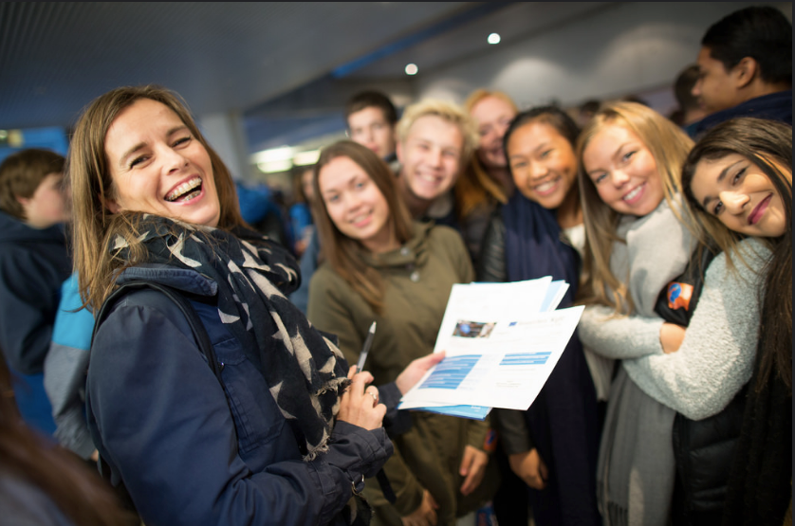
Discussion topics and learning
Why do we communicate research?
What are the common current means of research communication?
Choosing your communication method and audience
Effective verbal communication and the elevator speech
The elevator conversation
The awkward moment
The follow-up
Google is your friend

Slide 20
Why do we communicate research?
Quick class exercise – 5+5min
5min
In groups, come up with as many reasons for communicating research as you can
Write each on a post-it note
+5min
Report to class, iteratively
Pass all post-it notes to front

Slide 21
What are the common current means of research communication?
Quick class exercise – 10+5min
10min
In groups/pairs, come up with as many means for communicating research as you can;
Think about the media, the media type (and what are the implications/nuances), the language, style, anything else you think matters
Write each on a post-it note
+5min
Report to class, iteratively
Pass all post-it notes to front

Slide 22
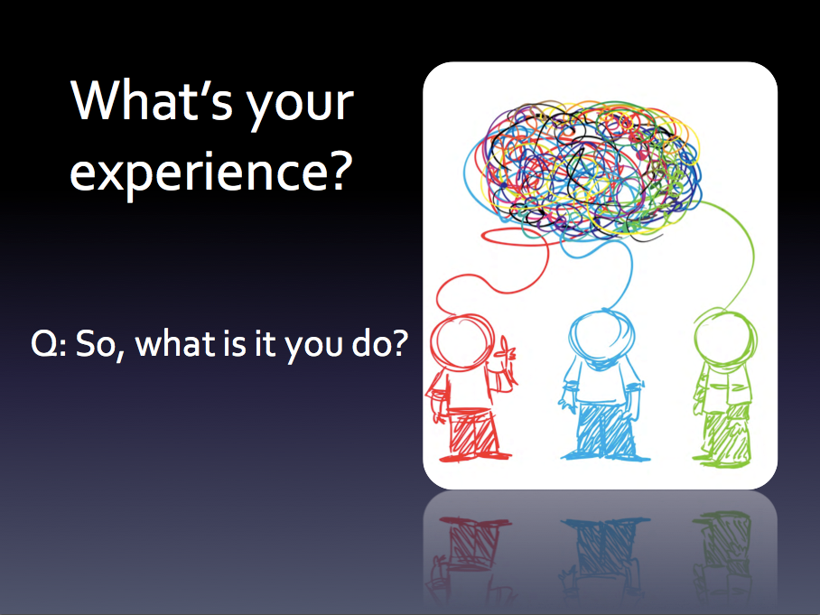
Mastering the skill: Communicate to persuade
Communication and communication of research is predicated by:
Having something to say
Being able to say it
Having someone to say it to…

Slide 23
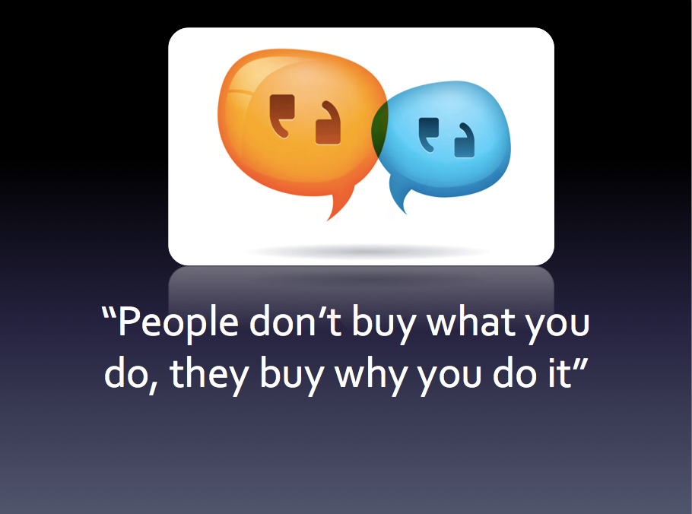

Slide 24
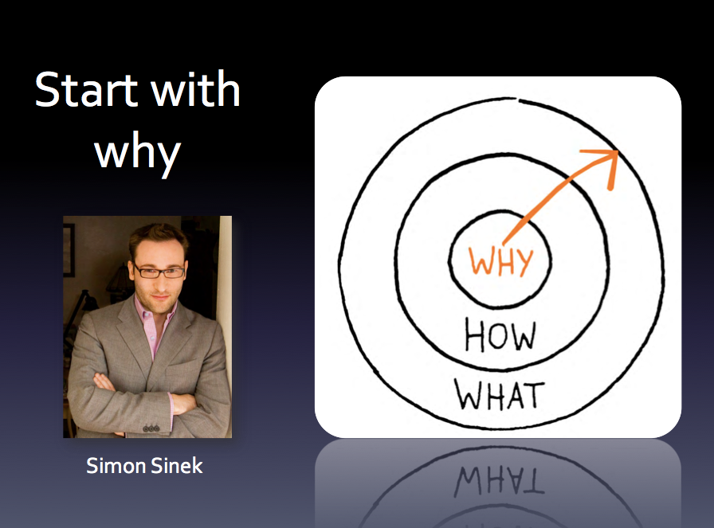

Slide 25
Nice things to watch – at home?
https://www.youtube.com/watch?v=GqsWKaR9Q6M – the question WHY
https://www.youtube.com/watch?v=2N03L6OaxeE – the STORY AND 5 QUESTIONS

Slide 26


Slide 27
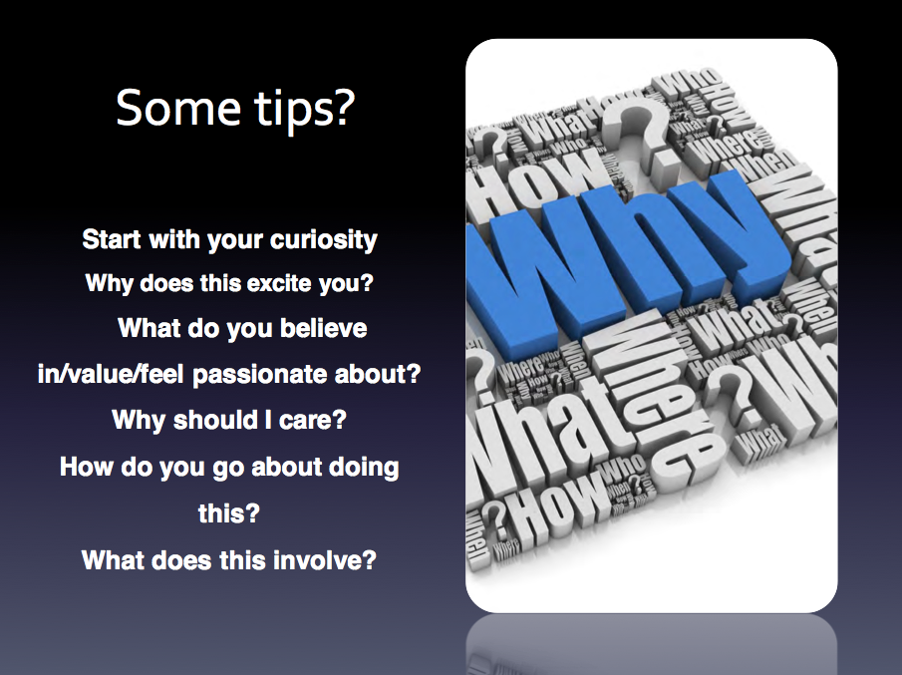

Slide 28
Examples
From tutors
and
From the class???

Slide 29
Individual Exercise – 10 minutes Read to class – 10 min

Slide 30
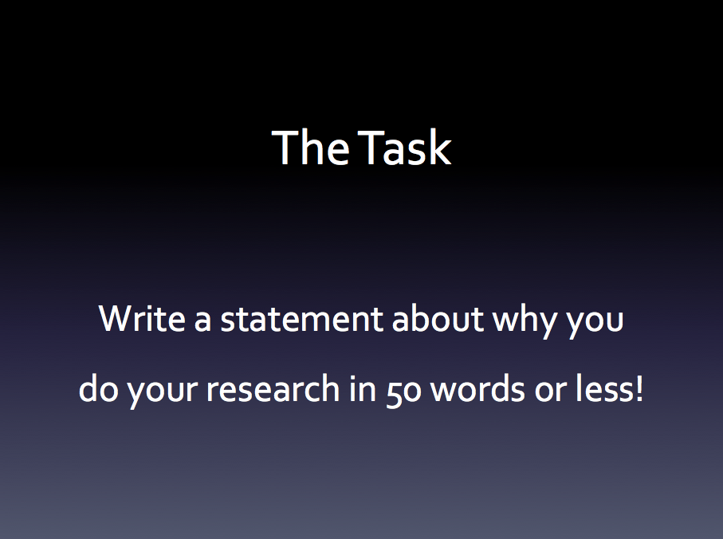

Slide 31
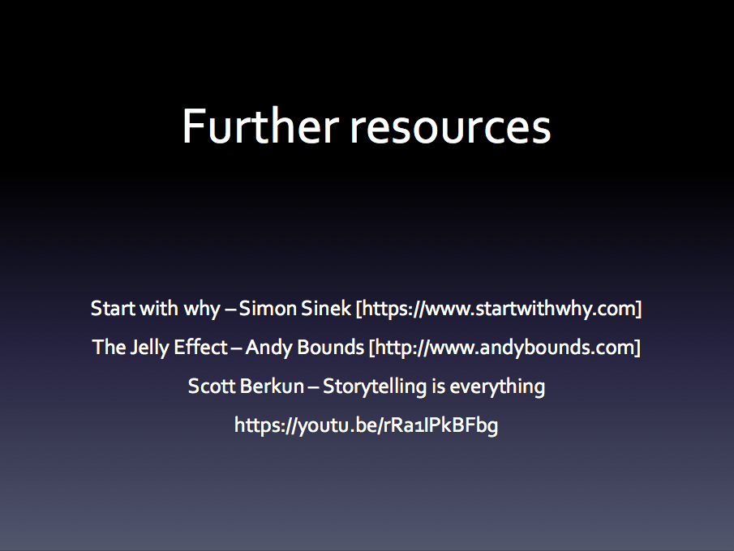

Slide 32
How to: Make the most of conferences and events

Slide 33
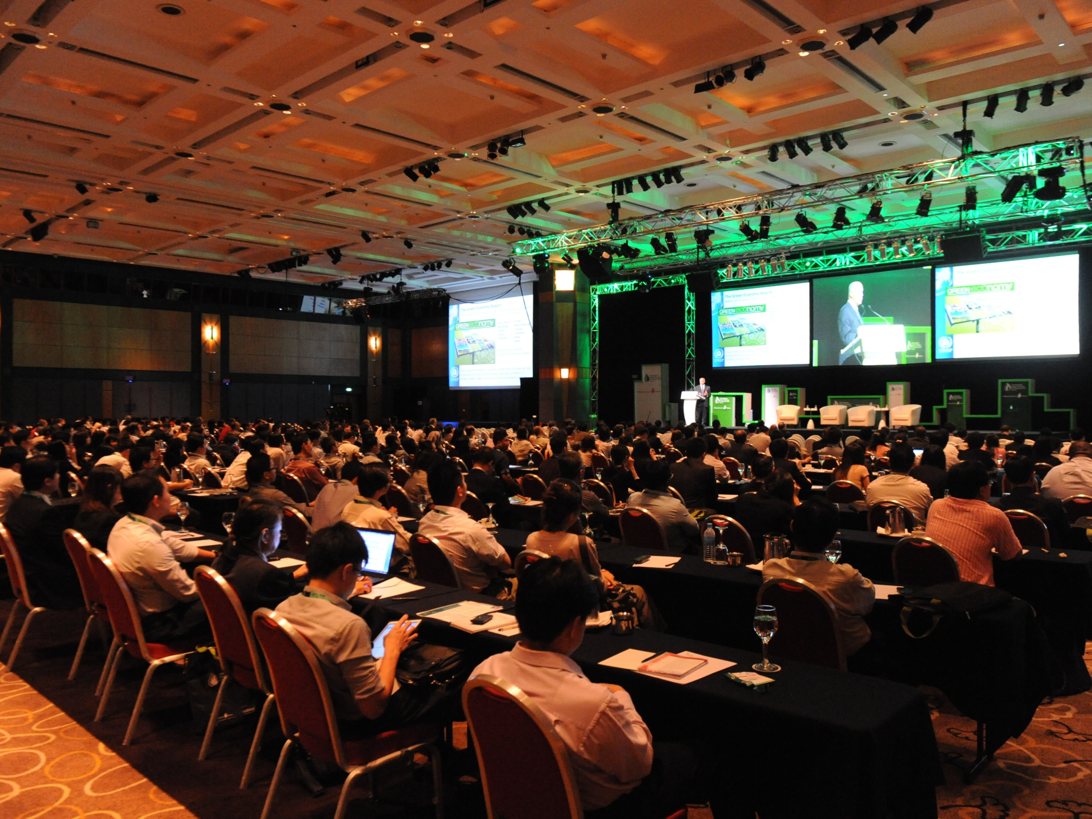
Conferences come in many different shapes and sizes and present many opportunities for career development. Many people, though, do not take full advantage of the networking opportunities on offer.

Slide 34
Conferences, meetings and workshops can:
Help you to grow and solidify your network.
Learn more about your field and discover cutting-edge knowledge.
Enhance your presentation and networking skills.
Forge career linkages
Promote yourself
Open up new opportunities.

Slide 35
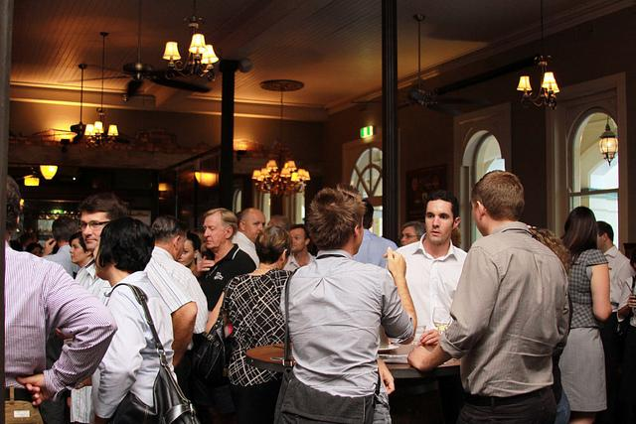
Networking:
a spectrum of activities that occur across time.
begins at first interaction, but continues throughout the lives of both parties.
aims to be mutually beneficial: to share, collaborate, inform, advise.
involves a myriad of actions and correspondences
career boosting

Slide 36
Three Rules of Networking
PREPARE
Think about why you are attending, what is your goal? Who is presenting? Who be there? Who will you speak with?
Explore what type of event it is and what might be expected of you.
Use social networks to get to know people in advance.
PARTICIPATE
Everyone is there for the same reasons, so don’t be afraid to go up and start a conversation.
Make the effort to speak with those you know and, importantly, anyone you don’t know. Be flexible and open to new opportunities.
PURSUE
Make sure you follow up with any leads or contacts to ensure projects come to fruition.
Don’t be afraid to contact keynote speakers following their talk.

Slide 37
Eight Networking Myths
I don’t need to network, people will find out about me as a result of my research and publications.
Networking with people outside my field is a waste of time.
Networking is about extracting something from someone else
I don’t need to network, because I’m not looking for work or a research partner.
I can’t network because I don’t have time.
I can’t network effectively because I am shy and introverted
Networking is a smarmy endeavour relegated to the domain of a used car salesman.
A leader in my field would never want to speak with me, an early career professional

Slide 38
Tips for Networking at Conferences
ALWAYS provide specific input/ present a paper. This creates an opportunity for people to see who you are and find our about your interests and expertise.
Use the lunches, drinks events, and tea and coffee time effectively. Keep your eyes and ears open so that you identify new people to meet and possible research opportunities.
Get people talking about their interests and what enthuses them. This creates for a positive networking experience.
Make sure you tell people about what you do and the value you can provide them so they understand how an alliance could be mutually beneficial.
Don’t forget to take notes!

Slide 39
Tips for Networking at Conferences
Importantly: listen to what they do so that you can identify possible connections and future collaborations
Take advantage of smaller gatherings (special interest groups, lunchtime sessions), this will increase the impact of your networking.
Approach anyone on their own. This is quick and easy win in terms of networking.
Poster sessions offer a great opportunity to speak with someone in-depth about their interests.
Focus on discussing positive things. Avoid talking negatively about the event or about attendees.
Have a business card to hand, or an online equivalent.
Ask people if you can follow-up with them at a later date.

Slide 40
The Social Event
Turn your mobile phone off. Using your mobile makes it more difficult for someone to come and speak to you.
Be enthusiastic and engaging.
Walk the room to make yourself familiar with your surroundings.
Look for who you do and don’t know. Perhaps start out be speaking to those you do know to build confidence..
Look for an “action nexus” – where a large group are gathering/conversing. This could provide a stimulus for conversation.
Remember: it’s easy to join in a conversation with a smaller group than to participate in the conversation of a much larger group.
Start by acknowledging the group with a smile, but wait for an appropriate moment to join the conversation.

Slide 41
Conversations Starters
Have you been to this event before?
Are you a member of this organisation/society?
How are you enjoying the event?
I see you’re from the University of Oxford. How do you like it there?
Nice view!
Hi! I’m…

Slide 42
Other useful phrases…
I could see how I can be of immediate benefit to your research group because…
I can see that there is synergy in our areas of research in that...
I could assist you with your efforts because I...
I would like to explore the potential to partner...
I can see there may be an opportunity to collaborate because...
Perhaps we can explore working together....

Slide 43
Conversations Closers
I really enjoyed our conversation. Do you mind if I follow up with you next week?
It was a pleasure meeting you. Can I get your business card?
Thank you for the opportunity to chat. I would love to continue our conversation. Are you on Twitter?
It was great speaking with you. Enjoy the rest of the event and hope to see you again soon!

Slide 44
REMEMBER
Networking is an important part of any academic career.
Networking allows you to influence how research develops.
Networking is an ongoing activity.
Networking opens up a range of “hidden” opportunities (invitations to join editorial committees, present keynotes, peer review…)
Networking is about communicating your interests, values and expertise and in making connections.

Slide 45
How to: Effective Email Follow-Ups

Slide 46
TASK
What do you do after the conference has finished?
In pairs, discuss the activities you undertake (or should undertake) after attending a conference?

Slide 47
Following Up
Make sure you have put some time aside to follow up any leads from your conference.
Remember to take notes and collect business cards or contact details so that you can follow up after the event.
Remember: it’s not networking if you don’t stay in touch.
Don’t be afraid to send an email showing your interest or expressing thanks.
It’s never too late to get in touch!

Slide 48
Example Follow-up Email
Dear Dr X
It was a pleasure meeting you at the Ecological Society of Amercia in Minneapolis last week. I appreciated the opportunity to briefly chat with you and Dr Y and Z outside the conference venue/hall/canteen. As you may recall, I am currently finishing up my postdoc at the University of Arizona and I am especially interested in freshwater megafish. I found our discussion very interesting and can see that there is definitely some synergy between our research areas. I would love to continue our conversation and explore the possibility of us collaborating. Would it be possible to arrange a short follow-up phone/Skype appointment in the coming weeks? Please let me know what times/dates would be best for you. Again, it was great meeting you. You can find out more about me on my LinkedIn profile: https://www.linkedin.com/in/kieran-fenby-hulse-46410460
I look forward to speaking with you further and to perhaps working together in the future.
Regards

Slide 49
Informational Interviews
Term understood in business, less used in academia. Aim of an informational interview is to:
Open the lines of communication
Exchange information
Plainly elucidate and understand each other’s offer or brand
Learn how you could craft a win-win partnership
Solve each other’s problems.
Informational interviews can be undertaken on Skype, by phone, or in person, and are great activities to undertake post conference. They are about finding out information so that you can explore the possibility of working together.

Slide 50
The Conversation
Remember to prepare for your meeting in advance:
Look at their University profile, personal website, or LinkedIn account.
What comes up from a google search, or google news search?
Do a journal/book search. Have they recently written a paper?
Do a conference search. Have they recently given a paper, or are they about to give a paer?

Slide 51
The Conversation
Keep it positive!
Remember to listen attentively.
Questions you might ask:
How did you get into this area of work?
What for you are the key areas of interest?
Who else should I be speaking to about this?
Don’t take up too much of their time. This is an initial exploration. Be concise and effective.
Send a follow-up Thank You note.
Very few academics receive thank you notes, so this will come as a welcome and appreciated surprise. (It will also amplify your brand!)

Slide 52
An example…
Dear Professor X,
It was a pleasure speaking with you today. I appreciate you taking the time to chat with me about your experiences in nuclear waste management. After our conversation, I am even more excited about the possibility of collaborating with you. Thank you again for the opportunity to speak with you and I look forward to working with you in the future. If I can assist you with anything, don’t hesitate to let me know.
Regards,
Y

Slide 53
So what next…
Make a note to contact them again in 3-4 months and, if you haven’t already, connect with them online.
Follow up correspondence should:
Deliver something of value: information that can assist them with their problem-solving, or is of value to them.
Share news or data about yourself – information that can inspire them.
Ask them a question about their work, or ask for advice.
I saw/read/heard this and thought of you…

Slide 54
How to: Boost your on-line profile

Slide 55
Finding out more
I recently attended your paper at the annual conference. As I had to catch a flight, I didn’t have time to speak with you. When I got home I wanted to get in touch and find out more about your work. What would I find from an online search of your name?
In pairs, discuss your presence online. What would the result of the search be? How would I find our more and would I be able to contact you?
When your next online, why not try googling yourself. What comes up first? What does this say about you and what can you to change or enhance this?

Slide 56
Online Networking
No longer an option – it’s a strategic element of networking and a common way for people to find out more about you and your work.
Digital trails can amplify your reputation and reach.
If you don’t have an online presence, the perception might be that you are not a contributing member of your community.
Like all networking, informational must flow both ways.

Slide 57
Where to start…
Question: what do you want to achieve?
Hidden opportunities?
New networks?
Learn who the trend-makers are?
Connect with decision-makers?
Gain insight about a community, field, job market?
Find a job, grant, fellowship?
Gain inspiration for new ideas?
Amplify your brand or reputation?
Promote yourself?

Slide 58
Social Media Strategy
Requires planning and preparation, execution, monitoring, and maintenance.
A page and a single tweet isn’t sufficient!
An active, rather than passive activity.
Need to consistently engage and interact with others.
Be proactive and reactive. Engage with the work of others as well as initiate discussions on your work.
Select which social media channels are right for you and your work.
Ensure that what you are doing is valuable and is enhancing your profile. Ensure your online network has meaning.
Be mindful. Everything you say is public and recorded.

Slide 59
LinkedIn
Over 300 million users, with many academics now with profiles.
Site focused on professional networking.
Increasing means of advertising jobs and searching for employment.
Used to develop inroads and support community-building.
Connecting with the professional sector as well as academia.
An opportunity to think about your brand and your value to the academic community and the wider public.

Slide 60
Twitter
Discursive and community-based platform
Allows you to share news, articles, best practice, and dialogue.
Tweet information that contributes to your community. This will help you establish yourself and your online presence.
Twitter is often used to advertise conferences and as a conference backchannel through the use of topic-based hashtags. This can alert you to new events as well as inform your thinking at the conference.

Slide 61
Research Gate / Academia.edu / Figshare
Sites which enable you to share links to your publications and papers (and, where possible, pre-print versions of your articles).
Research Gate and Figshare also allow you to share data sets, presentations, and audio-visual data.
Allow you to connect with researchers in your area and can provide recommendation of people to follow and research that might be of interest.

Slide 62
Blogs
Blogs can be time consuming, but are also great ways for you boost your profile, sharpen your thinking and writing skills, and obtain useful and critical feedback on work in progress. Before taking on a blog, though, you need to think through these questions:
What is the aim of the blog?
Who is your audience?
What you will write about?
Where will the material will come form?
How much time do you want to devote to the blog?
How often will you post?
What platform will you use?

Slide 63
Some Examples
Advice for PhDs:
https://thesiswhisperer.com/
Advice for researchers: https://theresearchwhisperer.wordpress.com/
Advice on academic writing:
https://patthomson.net/
On academic work in the social sciences:
http://blogs.lse.ac.uk/impactofsocialsciences/

Slide 64
How effectively do you communicate? (1h)
Interactive exercises on verbal communications
Prepare your 30 seconds pitch
Any of the 6 ways of pitching / human selling (verbal, written, email, blog, etc)
Share in pairs, with tutors, with class
Chose your pitch style – 3min (individual)
Preparation– 15min (individual)
Share thoughts around the table (3-4 min)
Hardest part of the pitch prep task?
Confidence level
Reflections
What new thing did you learn
Best part about the task
Share with class and get feedback!!!

Slide 65
Elevator Pitch
https://www.youtube.com/watch?v=LDpe9StfGTA – nice examples of mixed quality speeches☺
https://www.youtube.com/watch?v=bZTWx2bftaw – business elevator pitch
https://www.youtube.com/watch?v=XvxtC60V6kc – excellent – 6 types of elevator pitches

Slide 66
Summary of morning sessions - draw on the morning sessions and introduce the afternoon sessions – 15 min
Interactive exercise on learning done Tell us what were: - most memorable ideas you heard this morning? - most enjoyed exercise this morning? - most valuable “take away” this morning? - remember to do this after each half day! -

